Slide 1
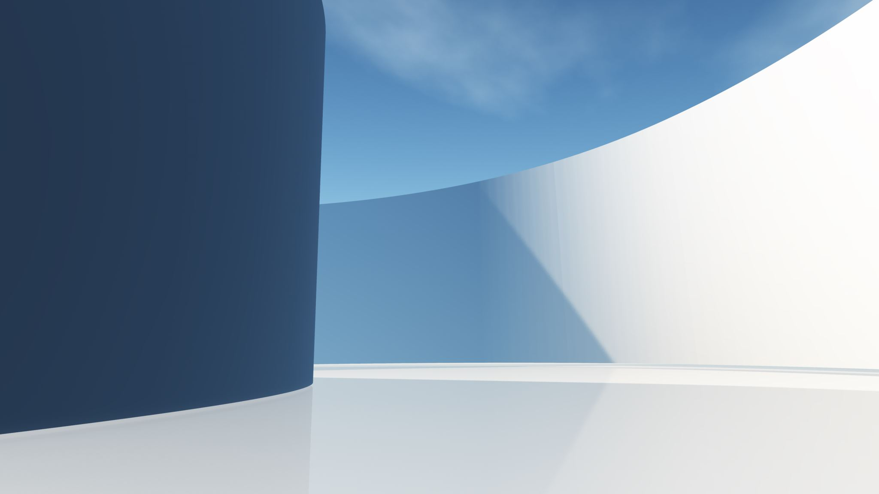
Flutter Basics
• Cross Platforms vs Native
• Why Flutter?
• Flutter Widgets
• Stateless vs Stateful
• Task !!

Slide 2
Cross Platforms vs Native
Native applications Native development is the process of building apps for a specific operating system like Android and iOS. Each OS has a specific design language, integrated development environment, and guidelines. You can develop Android apps using Kotlin and iOS apps using Objective-C or Swift. For example, if you want to publish iOS applications, you must use UIKit classes for the application’s main thread or dispatch queue. Similarly, there are OS-specific security requirements that you need to follow. Android app developers need to follow specific security guidelines.
Cross applications Cross-platform development involves the usage of a single code base across platforms. The codebase is combined with OS runtime environments for execution. So, these environments interpret the app’s code at runtime and execute it. The application’s source code is platform-independent, while the environment is platform-specific.

Slide 3
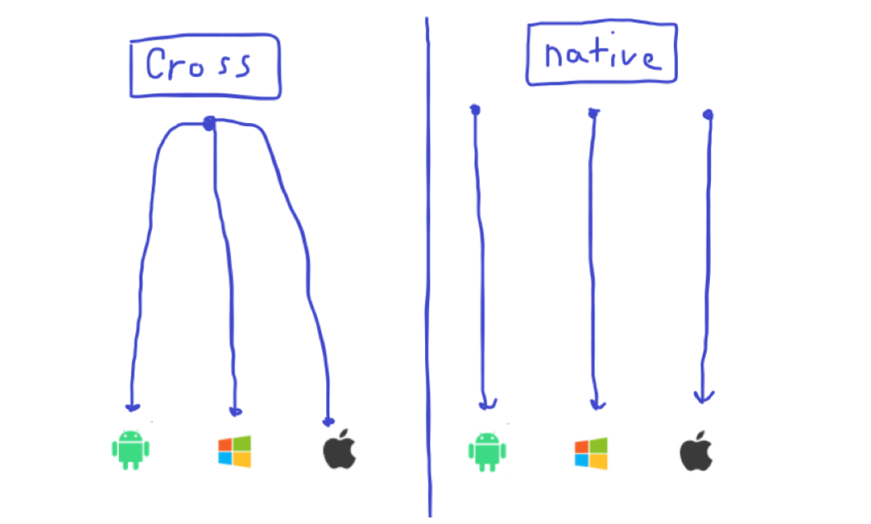

Slide 4
Why Flutter?
Flutter is a popular open-source mobile app development framework created by Google that offers a number of advantages over other frameworks. Here are a few reasons why developers choose Flutter:
Fast development: Flutter allows for fast app development with features such as hot reload, which lets developers see changes to the app's code in real-time, without having to restart the app.
Cross-platform development: Flutter allows developers to create apps for both iOS and Android platforms with a single codebase, reducing development time and costs.
Beautiful and customizable UI: Flutter makes it easy to create beautiful and customizable user interfaces with its built-in widgets and customizable themes.
High performance: Flutter apps are known for their high performance and fast rendering, thanks to Flutter's use of Dart language and its own rendering engine.
Large and growing community: Flutter has a large and growing community of developers, which means that there are plenty of resources and support available for those who are just starting out or looking to improve their skills.
Overall, Flutter is a great choice for developers looking to create high-quality, cross-platform apps quickly and efficiently, with a beautiful and customizable UI and high performance.

Slide 5
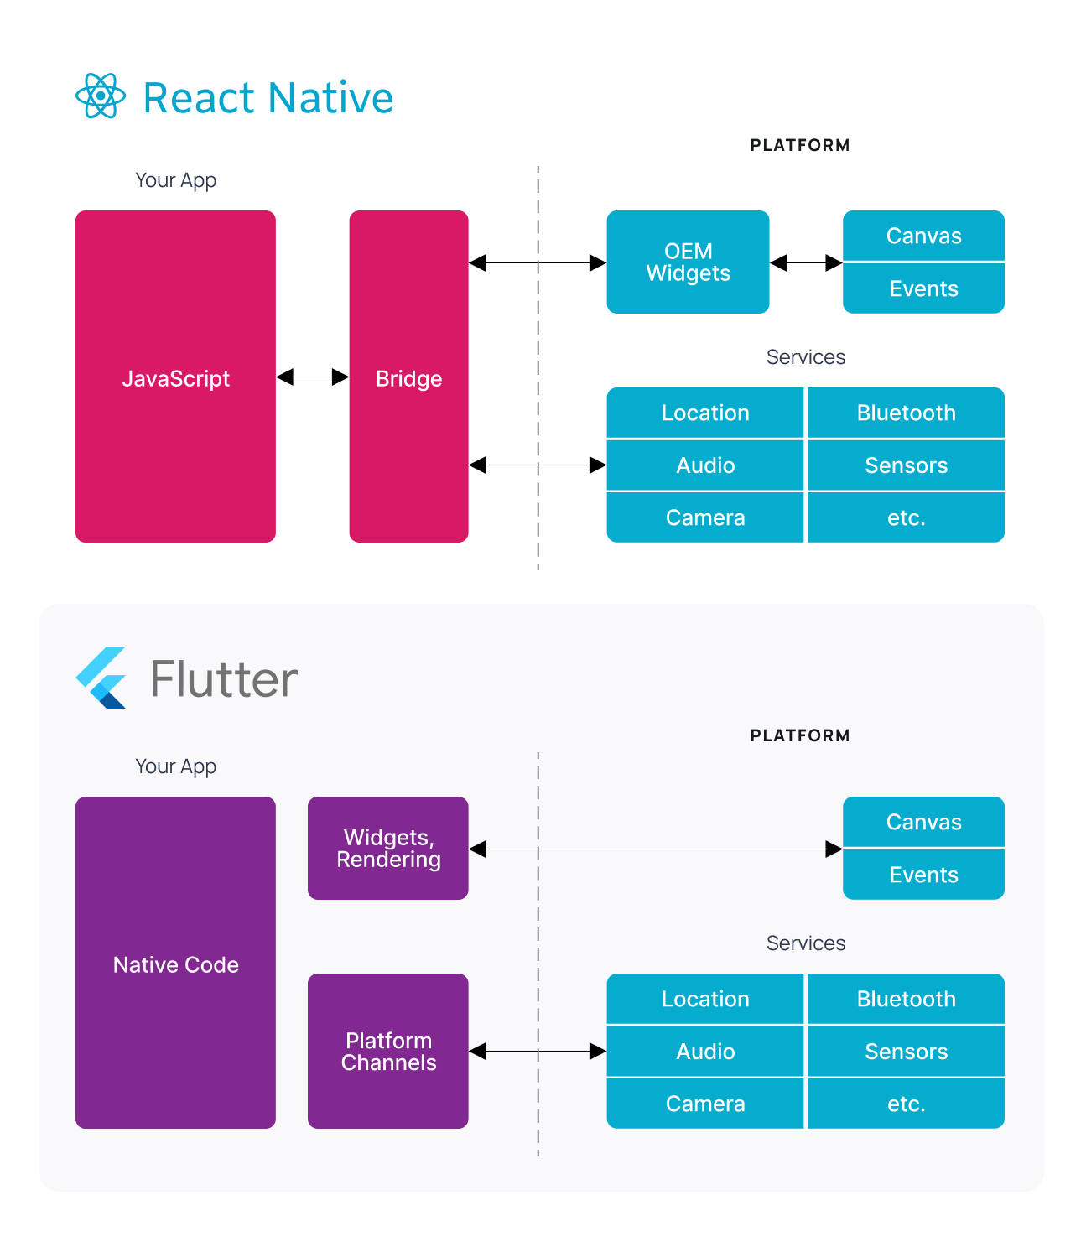
Why Flutter?
How Flutter is Fast?
• Dart language and Flutter's architecture: Flutter uses the Dart programming language, which is compiled to native code, whereas React Native uses JavaScript, which is interpreted. This means that Flutter apps can run natively and don't require a JavaScript bridge to communicate with the platform, resulting in faster performance. In addition, Flutter's reactive architecture allows it to be more efficient in handling UI updates, resulting in smoother animations and transitions.
• Widget rendering: Flutter uses its own rendering engine to draw widgets, which allows for more control over how widgets are drawn and optimized for performance. In contrast, React Native relies on the native platform's rendering engine, which can make it more challenging to optimize performance.
• Flutter's tooling and development workflow are designed to be fast and efficient, with features like hot reload that allow developers to see changes to their code in real-time. React Native also has hot reloading, but it can be less reliable than Flutter's implementation.

Slide 6
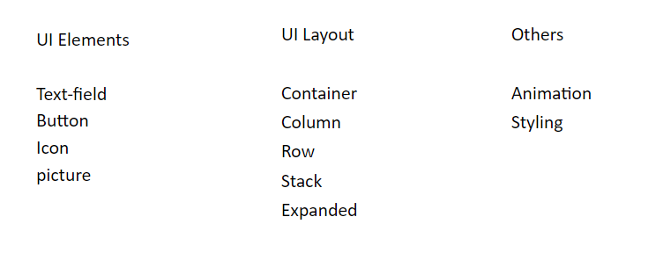
Flutter Widgets
Widgets are the central class hierarchy in the Flutter framework. A widget is an immutable description of part of a user interface.
In flutter, Widget is a way to declare and construct UI

Slide 7
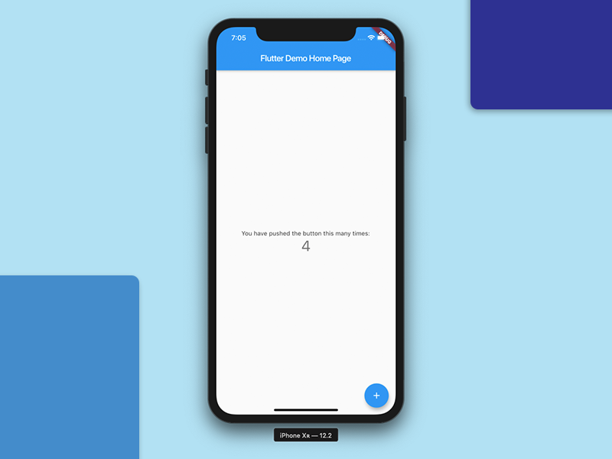
Let’s Code ☺

Slide 8

How App Runs?
From main Function
RunApp( object ) Function
The RunApp() function takes the given Widget and makes it the root of the widget tree

Slide 9
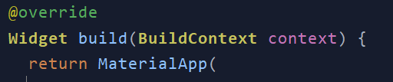
Material App
An application that uses material design.
A convenience widget that wraps a number of widgets that are commonly required for material design applications. It builds upon a WidgetsApp by adding material-design specific functionality

Slide 10
Scaffold
Scaffold is used under MaterialApp, it gives you many basic functionalities, like AppBar, BottomNavigationBar, Drawer, FloatingActionButton, etc.
The Scaffold is designed to be the single top-level container for a MaterialApp although it is not necessary to nest a Scaffold.

Slide 11
Time For Break !!
Back After 15 min ☺

Slide 12
What is state ?
According to Flutter, State is the information that can be read synchronously when the widget is built and might change during the lifetime of the widget. State objects are created by the framework. ... setState() sets properties of state object which in turn triggers the update to the UI.

Slide 13
Stateless vs Stateful Widgets
Stateless
A widget that does not require mutable state
A stateless widget is a widget that describes part of the user interface by building a constellation of other widgets that describe the user interface more concretely.
Stateful
A widget that has mutable state.
read synchronously when the widget is built
might change during the lifetime of the widget
A stateful widget is a widget that describes part of the user interface by building a constellation of other widgets that describe the user interface more concretely

Slide 14
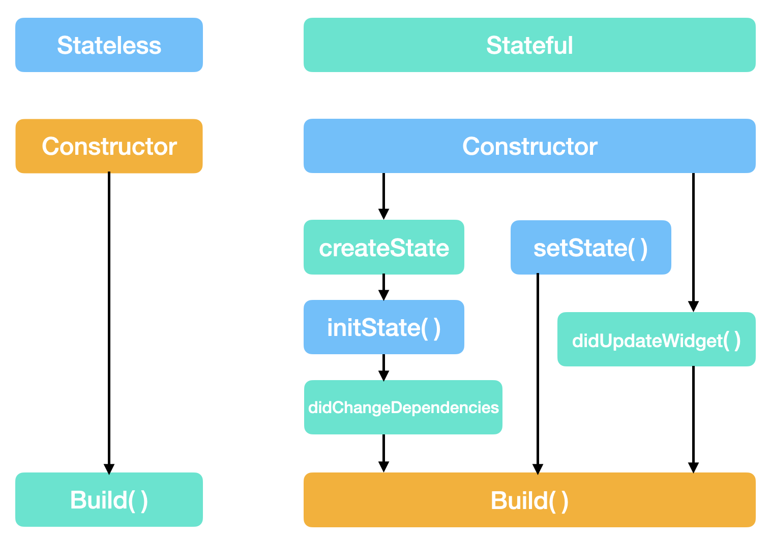
Stateful Widget Life-Cycle
Why we need stateless widgets? (Bonus) ☺

Slide 15
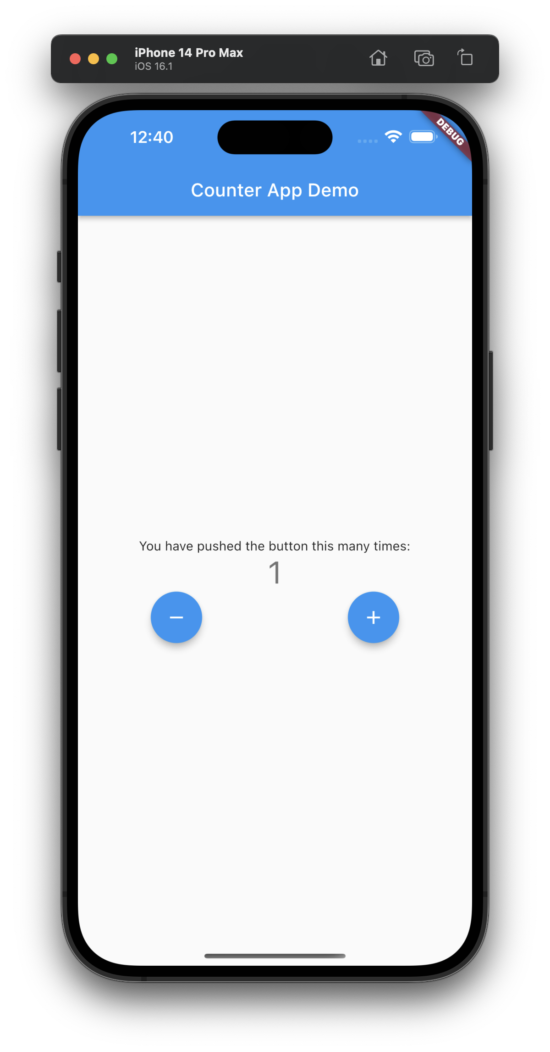
Task
Let’s implement the following screen
• What’s the Layout widgets used?
• What’s UI Elements Used?
• It’s statless Screen or stateful Screen?
• Correct we need column and a Row for the buttons ☺
• Correct We need Text Widget ☺
• Correct It’s a Stateful Screen ☺

Slide 16
Thank You!!
Don’t forget the feedback ☺

